Slide 1
The Evolution of the Fourteenth Amendment and Equal Protection
Through Supreme Court Cases
Presented by
Christopher Bryant
College of Law
University of Cincinnati
October 3, 2016
chris.bryant@uc.edu

Slide 2
PROPOSING the Fourteenth Amendment
The Thirty-ninth Congress
(1865-67)

Slide 3
Statutory Backdrop to the Fourteenth Amendment
The Civil Rights Act of 1866

Slide 4
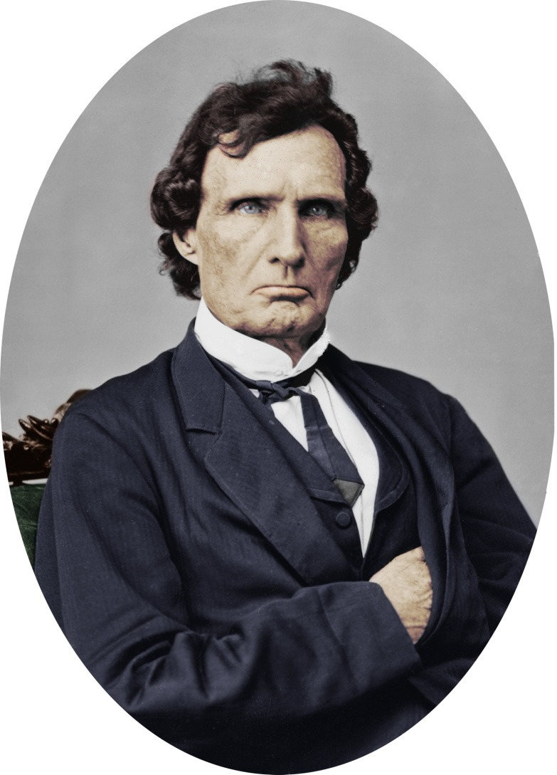
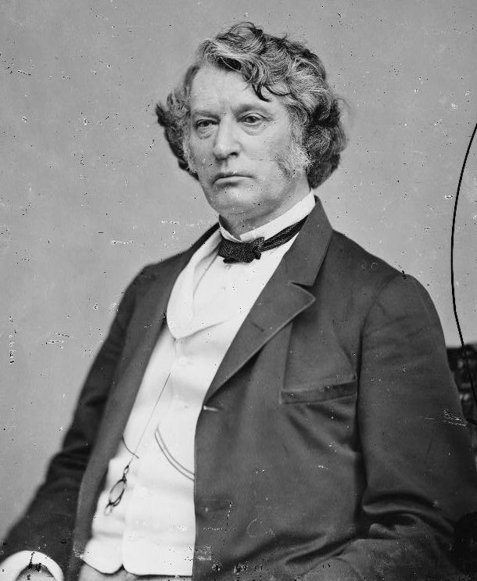
Radical Republicans

Slide 5
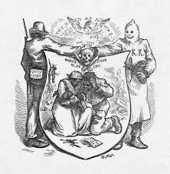
Black Codes
Notes:
Former confederate states pass “Black Codes”
impose disabilities on freedmen
limiting or denying their civil rights
Congress responds w/ Civil Rights Act of 1866
enacted under Naturalization power &
Section 2 of the Thirteenth Amendment

Slide 6
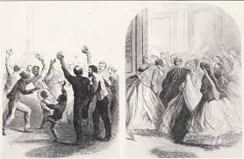
Civil Rights Act 1866

Slide 7
CRA of 1866
What did it do?
What gave Congress the power to enact it?

Slide 8
Civil Rights Act of 1866
“. . . all persons born in the United States and not subject to any foreign power, excluding Indians not taxed, are hereby declared to be citizens of the United States; and such citizens, of every race and color, without regard to any previous condition of slavery or involuntary servitude, except as a punishment for crime whereof the party shall have been duly convicted, shall have the same right, in every State and Territory in the United States, to make and enforce contracts, to sue, be parties, and give evidence, to inherit, purchase, lease, sell, hold, and convey real and personal property, and to full and equal benefit of all laws and proceedings for the security of person and property, as is enjoyed by white citizens, and shall be subject to like punishment, pains, and penalties, and to none other, any law, statute, ordinance, regulation, or custom, to the contrary notwithstanding.”

Slide 9
Civil Rights Act of 1866: Citizenship Grant
“. . . all persons born in the United States and not subject to any foreign power, excluding Indians not taxed, are hereby declared to be citizens of the United States”

Slide 10
CRA of 1866: Rights Protected
Section One:
“[all U.S.] citizens . . . shall have the same right to make and enforce contracts, to sue, be parties, and give evidence, to inherit, purchase, lease, sell, hold, and convey real and personal property, and to full and equal benefit of all laws and proceedings for the security of person and property, as is enjoyed by white citizens”

Slide 11
The Fourteenth Amendment
Proposal and Ratification

Slide 12
Bingham’s Proposal
The Congress shall have power to make all laws which shall be necessary and proper to secure to the citizens of each State all privileges and immunities of citizens in the several States; and to all persons in the several States equal protection in the rights of life, liberty, and property.

Slide 13
Section 1 as adopted
All persons born or naturalized in the United States and subject to the jurisdiction thereof, are citizens of the United States and of the State wherein they reside. No State shall make or enforce any law which shall abridge the privileges or immunities of citizens of the United States; nor shall any State deprive any person of life, liberty, or property, without due process of law; nor deny to any person within its jurisdiction the equal protection of the laws.

Slide 14
Section 5 as adopted
The Congress shall have power to enforce, by appropriate legislation, the provisions of this article.

Slide 15
Fourteenth Amendment
Bingham’s First Draft
The Final Product
No definition of citizenship
SOLELY a conferral of power on Congress
Extends to private action?
Broader authority for Congress?
Defines citizenship
Operative protection of rights
Constraint upon States
Sections 2-4
Laws must be “appropriate”

Slide 16
Ratification of the Fourteenth Amendment
Contentious
  Election of 1866
Compulsory?
  Congressional representation contingent upon same

Slide 17
“One Pervading Purpose”
Of Reconstruction Amendments (13th, 14th & 15th)
  According to The Slaughter-House Cases majority:
  “the freedom of the slave race, the security and firm establishment of that freedom, and the protection of the newly made freeman and citizen from the oppressions of those who had formerly exercised unlimited dominion over him”

Slide 18
Privileges & Immunities Clause

Slide 19
History of “Privileges” & “Immunities”
Article IV of the Articles of Confederation
Article IV, section 2 of the Constitution (of 1789)
Section 1 of the Fourteenth Amendment (1868)

Slide 20
Article IV of the Article of Confederation
“The better to secure and perpetuate mutual friendship and intercourse among the people of the different States in this Union, the free inhabitants of each of these States, paupers, vagabonds, and fugitives from justice excepted, shall be entitled to all privileges and immunities of free citizens in the several States; and the people of each State shall free ingress and regress to and from any other State, and shall enjoy therein all the privileges of trade and commerce, subject to the same duties, impositions, and restrictions as the inhabitants thereof respectively . . . .”

Slide 21
Article IV of the Article of Confederation
“. . . the free inhabitants of each of these States, paupers, vagabonds, and fugitives from justice excepted, shall be entitled to all privileges and immunities of free citizens in the several States; . . . .”

Slide 22
Article IV, Sec. 2 (U.S. Const.)
“The Citizens of each State shall be entitled to all Privileges and Immunities of Citizens in the several States.”

Slide 23
Corfield v. Coryell (1823)
“[W]hat are the privileges and immunities of citizens of the several States? We feel no hesitation in confining these expressions to those privileges and immunities which are fundamental; which belong of right to the citizens of all free governments, and which have at all times been enjoyed by citizens of the several States which compose this Union, from the time of their becoming free, independent, and sovereign. What these fundamental principles are it would be more tedious than difficult to enumerate. They may all, however, be comprehended under the following general heads: protection by the government, with the right to acquire and possess property of every kind and to pursue and obtain happiness and safety, subject, nevertheless, to such restraints as the government may prescribe for the general good of the whole.”

Slide 24
Corfield v. Coryell (1823)
“those privileges and immunities which are fundamental;
“which belong of right to the citizens of all free governments, and
“which have at all times been enjoyed by citizens of the several States which compose this Union, from the time of their becoming free, independent, and sovereign.
“comprehended under the following general heads:
  protection by the government,
  with the right to acquire and possess property of every kind and
  to pursue and obtain happiness and safety,
  subject, nevertheless, to such restraints as the government may prescribe for the general good of the whole.”

Slide 25
Corfield v. Coryell (1823)
Fundamental
Belong to the citizens of all free governments, and
“which have at all times been enjoyed by citizens of the several States which compose this Union, from the time of their becoming free, independent, and sovereign.”

Slide 26
Corfield v. Coryell (1823)
“comprehended under the following general heads:
  protection by the government,
  with the right to acquire and possess property of every kind and
  to pursue and obtain happiness and safety,
  subject, nevertheless, to such restraints as the government may prescribe for the general good of the whole.”

Slide 27
Bingham’s Proposal
The Congress shall have power to make all laws which shall be necessary and proper to secure to the citizens of each State all privileges and immunities of citizens in the several States; and to all persons in the several States equal protection in the rights of life, liberty, and property.

Slide 28
Section 1
All persons born or naturalized in the United States and subject to the jurisdiction thereof, are citizens of the United States and of the State wherein they reside. No State shall make or enforce any law which shall abridge the privileges or immunities of citizens of the United States; nor shall any State deprive any person of life, liberty, or property, without due process of law; nor deny to any person within its jurisdiction the equal protection of the laws.

Slide 29
Privileges or Immunities Clause
No State shall make or enforce any law which shall abridge the privileges or immunities of citizens of the United States
. . . .

Slide 30
Fourteenth Amendment
Bingham’s First Draft
The Final Product
No definition of citizenship
SOLELY a conferral of power on Congress
Extends to private action?
Broader authority for Congress?
Defines citizenship
Operative protection of rights
Constraint upon States
Sections 2-4
Laws must be “appropriate”

Slide 31
“One Pervading Purpose”
Of Reconstruction Amendments (13th, 14th & 15th)
  According to The Slaughter-House Cases majority:
  “the freedom of the slave race, the security and firm establishment of that freedom, and the protection of the newly made freeman and citizen from the oppressions of those who had formerly exercised unlimited dominion over him”

Slide 32
The Slaughter-House Cases
83 U.S. (16 Wall.) 36 (1873)
Act I in the Tragedy of Reconstruction

Slide 33
What are the Ps or Is of U.S. citizens?
1) Miller’s opinion for the Court in The Slaughter-House Cases
2) Field’s dissent in The Slaughter-House Cases
3) Direct protection of “fundamental” rights
4) Individual rights in first eight amendments
    Bill of Rights
5) Open-ended/”blank check”

Slide 34
Field’s Dissent
“What the [Privileges and Immunities Clause of Article IV] did for the protection of the citizens of one State against hostile and discriminating legislation of other States, the fourteenth amendment does for the protection of every citizen of the United States against hostile and discrimi-nating legislation against him in favor of others, whether they reside in the same or in different States.”

Slide 35
Ps/Is, According to Field
SAME as the Ps/Is protected by Article IV
Corfield v. Coryell (Washington, J., 1823):

Slide 36
Corfield v. Coryell (1823)
Fundamental
Belong to the citizens of all free governments, and
“which have at all times been enjoyed by citizens of the several States which compose this Union, from the time of their becoming free, independent, and sovereign.”

Slide 37
Corfield v. Coryell (1823)
“comprehended under the following general heads:
  protection by the government,
  with the right to acquire and possess property of every kind and
  to pursue and obtain happiness and safety,
  subject, nevertheless, to such restraints as the government may prescribe for the general good of the whole.”

Slide 38
CRA of 1866
Section One:
“[all U.S.] citizens . . . shall have the same right to make and enforce contracts, to sue, be parties, and give evidence, to inherit, purchase, lease, sell, hold, and convey real and personal property, and to full and equal benefit of all laws and proceedings for the security of person and property, as is enjoyed by white citizens”

Slide 39
Miller’s View
CONTRASTS Privileges/Immunities of 14th A. (X)
With the Privileges/Immunities of Article IV: (Y)
  Art IV: “The Citizens of each State shall be entitled to all Privileges and Immunities of Citizens in the several States.”
    Defined in Corfield v. Coryell (1823)
  XIV Amendment: “No State shall make or enforce any law which shall abridge the privileges or immunities of citizens of the United States”
X≠Y

Slide 40
Corfield v. Coryell (1823)
“[W]hat are the privileges and immunities of citizens of the several States? We feel no hesitation in confining these expressions to those privileges and immunities which are fundamental; which belong of right to the citizens of all free governments, and which have at all times been enjoyed by citizens of the several States which compose this Union, from the time of their becoming free, independent, and sovereign. What these fundamental principles are it would be more tedious than difficult to enumerate. They may all, however, be comprehended under the following general heads: protection by the government, with the right to acquire and possess property of every kind and to pursue and obtain happiness and safety, subject, nevertheless, to such restraints as the government may prescribe for the general good of the whole.”

Slide 41
Corfield v. Coryell (1823)
“those privileges and immunities which are fundamental;
“which belong of right to the citizens of all free governments, and
“which have at all times been enjoyed by citizens of the several States which compose this Union, from the time of their becoming free, independent, and sovereign.
“comprehended under the following general heads:
  protection by the government,
  with the right to acquire and possess property of every kind and
  to pursue and obtain happiness and safety,
  subject, nevertheless, to such restraints as the government may prescribe for the general good of the whole.”

Slide 42
Corfield v. Coryell (1823)
Fundamental
Belong to the citizens of all free governments, and
“which have at all times been enjoyed by citizens of the several States which compose this Union, from the time of their becoming free, independent, and sovereign.”

Slide 43
Corfield v. Coryell (1823)
“comprehended under the following general heads:
  protection by the government,
  with the right to acquire and possess property of every kind and
  to pursue and obtain happiness and safety,
  subject, nevertheless, to such restraints as the government may prescribe for the general good of the whole.”

Slide 44
Corfield v. Coryell (1823)
Miller:
“nearly every civil right for the establishment and protection of which organized government is instituted”
NOT protected by the FOURTEENTH Amendment
  U.S. citizenship vs. State citizenship
  TOO radical a change in constitutional structure

Slide 45
Ps or Is (14th A.) according to Miller
Rights supplied by federal (constitutional?) law
  Travel to national capital
  Access to seaports
  Use of navigable waters
  Protection when on the high seas
    Or when in foreign country
  Writ of Habeas Corpus
  Right to assemble and petition

Slide 46
Direct Protection Interpretation
Fourteenth Amendment guarantees not just equality or “parity” of right
But protects right itself from infringement

Slide 47
Bill of Rights Interpretation
Makes individual rights in first 8 amendments
Limitations on STATE as well as federal power
  Overruling Barron v. Baltimore
  Senator Howard’s speech

Slide 48
“Blank check” Theory
Cannot be defined
Evolving/future discovery
By WHOM?

Slide 49
Congressional Reconstruction
1869-1877

Slide 50
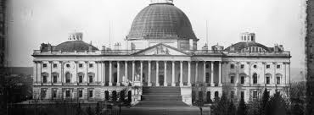
Congress supreme

Slide 51
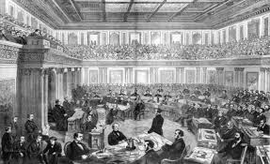
Impeachment of Johnson

Slide 52
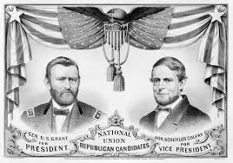
Election of 1868

Slide 53
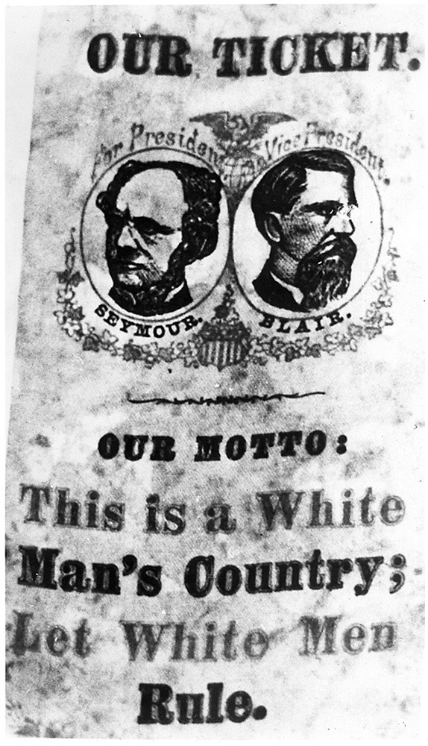
Democrat ticket for election of 1868

Slide 54
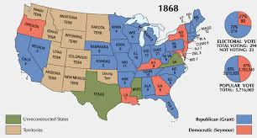
Election of 1868

Slide 55
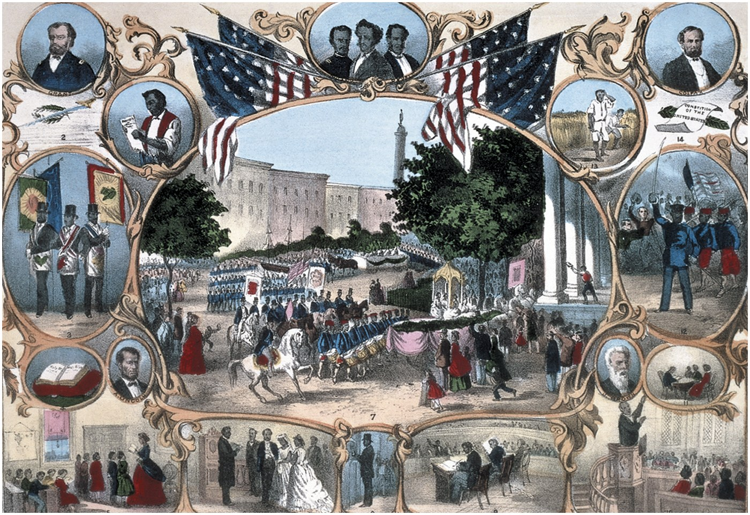
The 15th Amendment

Slide 56
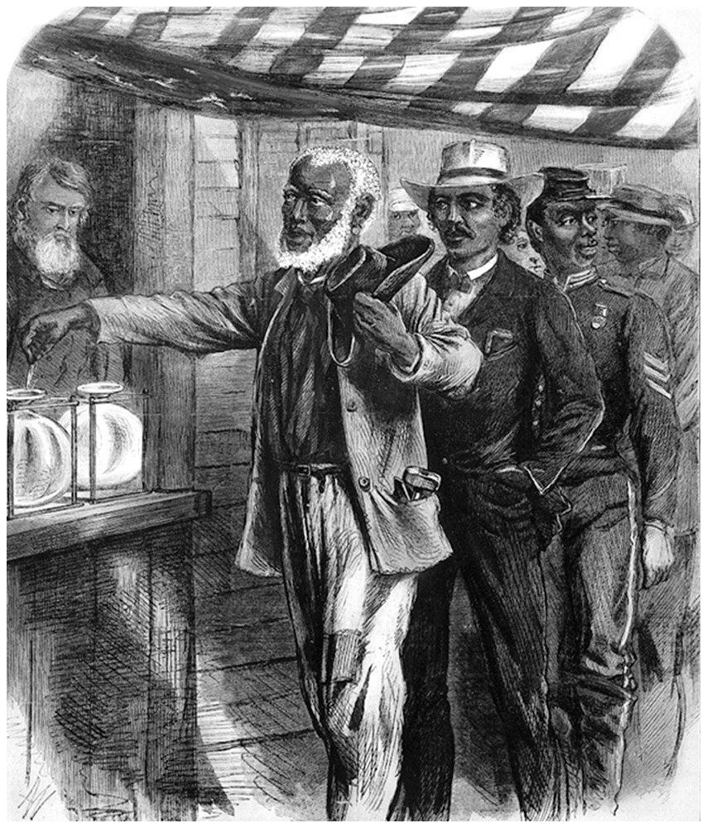
“The First Vote”

Slide 57
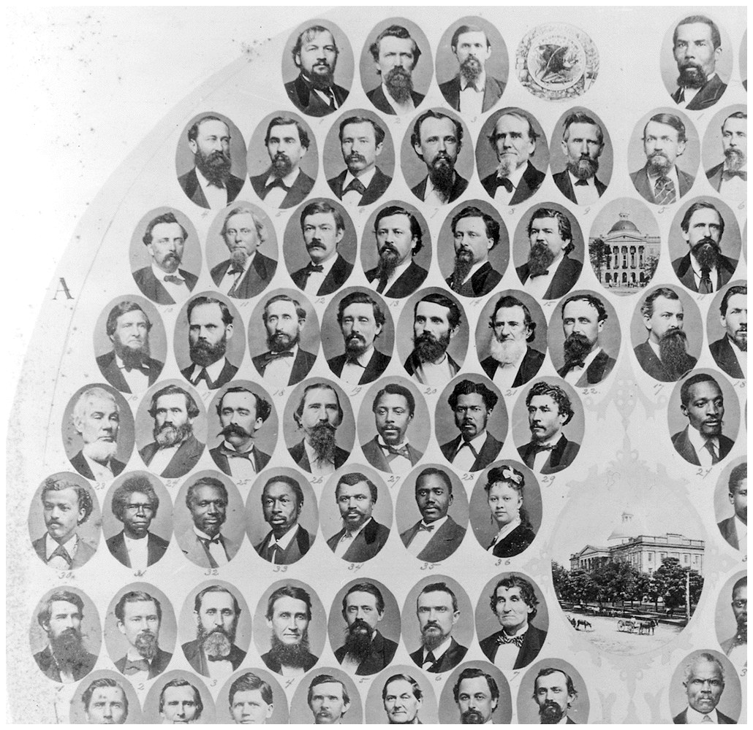
Black and white members of MS Senate, 1874-5

Slide 58
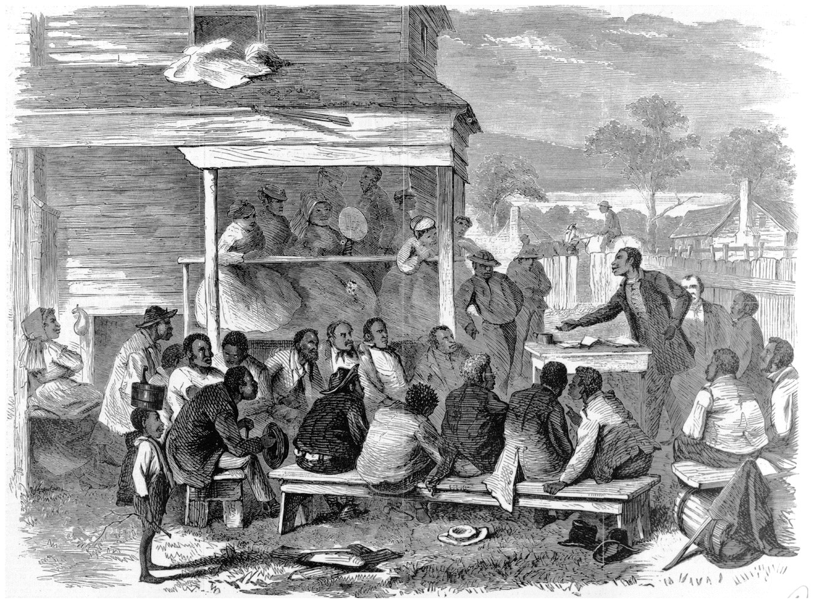
Blacks electioneering among blacks

Slide 59
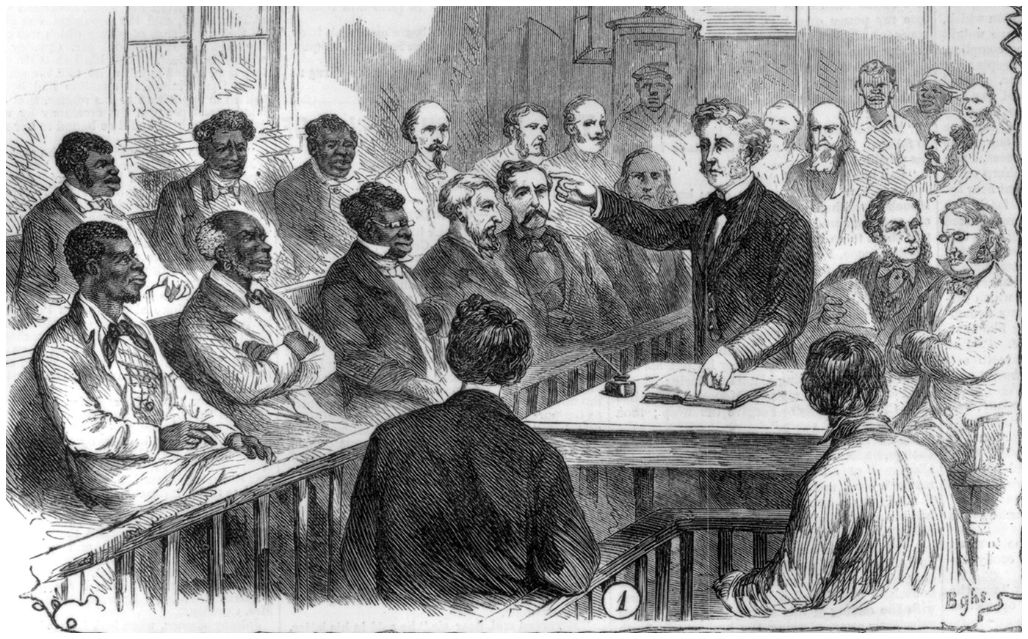
First time blacks and whites serving together on a jury

Slide 60
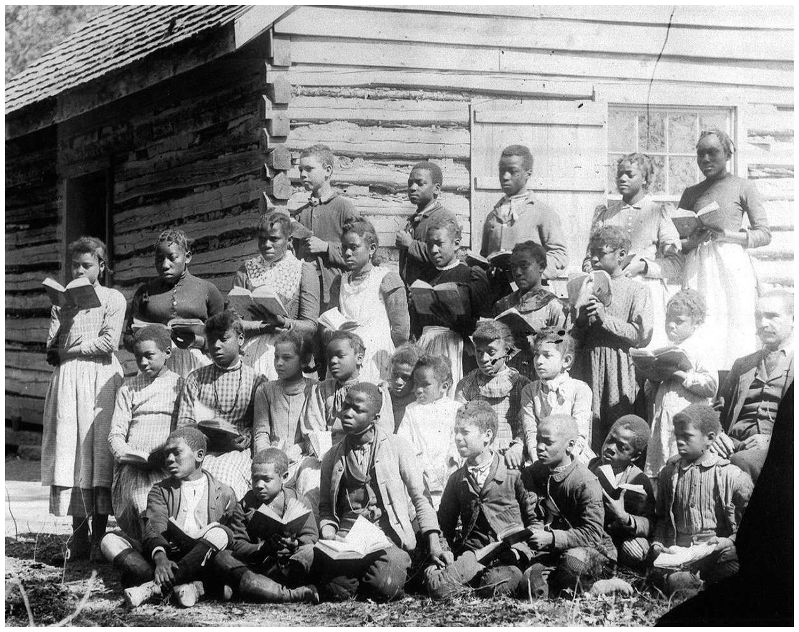
Black students outside schoolhouse

Slide 61
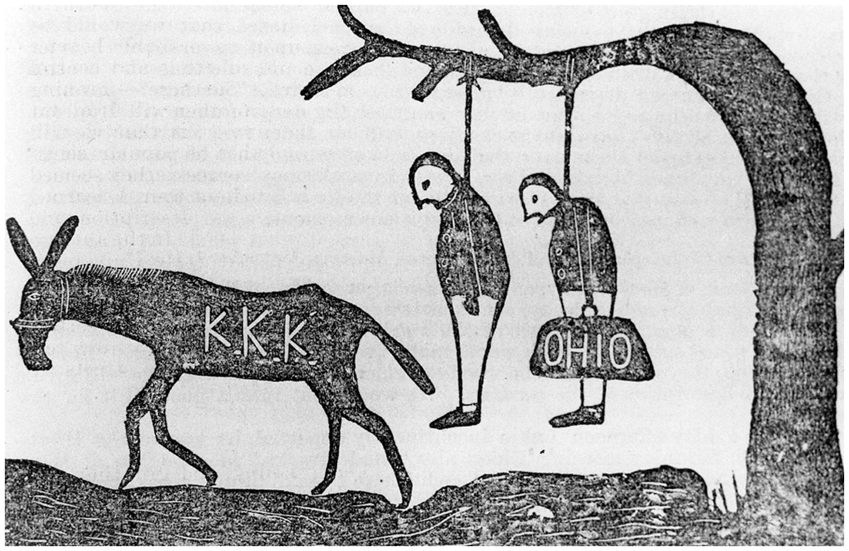
KKK forced many Republicans from positions

Slide 62
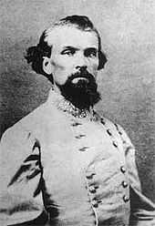
Nathan Bedford Forrest

Slide 63
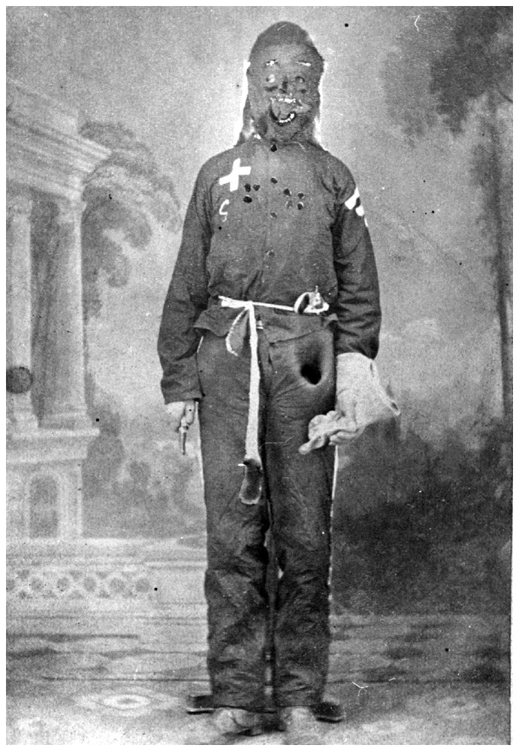
MS Klan member in his hooded disguise

Slide 64
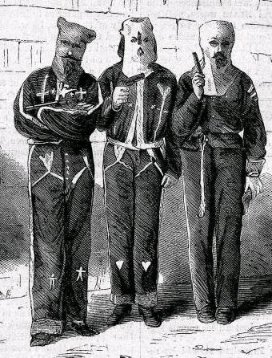
Klan: resented blacks getting ahead

Slide 65
Colfax Massacre
Worst Klan violence in 19th century
Blacks in Grant Parish, LA, in 1873 tired to organize selves to prevent Klan from disrupting local government
After 3 weeks of standoff, whites attacked black town and slaughtered everyone in their path: 280 blacks died

Slide 66
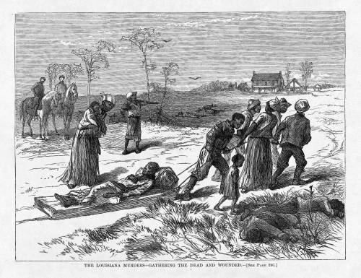
Colfax Massacre

Slide 67
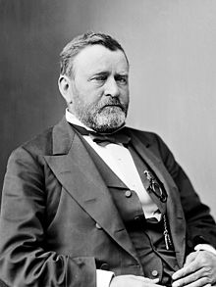
Grant as president

Slide 68
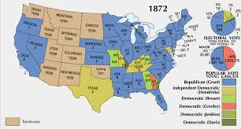
Election 1872

Slide 69
1875 Act & the Civil Rights Cases
Judicial Interment of Reconstruction
&
Birth of the
State-Action Doctrine

Slide 70
The Civil Rights Act of 1875
High-water Mark
for (the first)
Reconstruction

Slide 71
Civil Rights Act of 1875, Section 1
Provided that “all persons within the jurisdiction of the United States shall be entitled to the full and equal enjoyment of the accommodations, advantages, facilities, and privileges of inns, public conveyances on land or water, theatres, and other places of public amusement . . . ”

Slide 72
Civil Rights Act of 1875, Section 1
“. . . subject only to the conditions and limitations established by law and applicable alike to citizens of every race and color, regardless of any condition of servitude.”
Notes:
Sumner’s effort to require desegregated schools fell just short of adoption.
See Michael W. McConnell, Orignalism and the Desegregation Decisions, 81 VA. L. REV. 947 (1995); see also Michael Klarman, From Jim Crow to Civil Rights: The Supreme Court and the Struggle for Racial Equality (2004).

Slide 73
Civil Rights Act of 1875, Section 2
Section 2 provided criminal penalties and authorized civil suits for the award of monetary penalties.

Slide 74
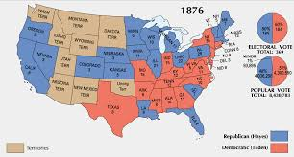
Election of 1876

Slide 75
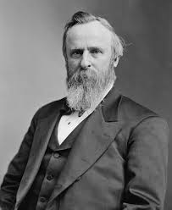
Rutherford B. Hayes

Slide 76
The Civil Rights Cases
Act II in the Tragedy of reconstruction

Slide 77
The Civil Rights Act of 1875
Guaranteed equal accommodations in inns, public conveyances, and places of public amusement
Without distinction regarding race, color, or previous condition of servitude
Civil and criminal penalties for violation

Slide 78
The Civil Rights Cases
109 U.S. 3 (1883)
Supreme Court voids the Act as unconstitutional
  Opinion for the Court by Justice Bradley
  Reason: No source of congressional power
    Too attenuated to slavery
    No “state action”
Sole dissenter: Justice John Marshall Harlan
  Don’t need state action (guarantee of equal citizenship)
  Got it in any event (special status of inns, conveyances, etc.)

Slide 79
Strauder v. West Virginia
100 U.S. 303 (1880)

Slide 80
Overview of Strauder (1880)
W Va law precluded blacks from jury service
Strauder, a black man, was convicted of murder
  In W Va state court
  Had sought “removal” to federal ct under federal civil right act
Justice Strong wrote for the Supreme Court majority
  Reversing conviction
  Finding W VA statute to be in violation of the 14th Amendment
  And upholding federal statute authorizing removal to fed ct
Two Justices dissented without opinion
Noble ruling, but easily evaded
Notes:
The law of the State . . . is as follows: “All white male persons who are twenty-one years of age and who are citizens of this State shall be liable to serve as jurors, except as herein provided.” The persons excepted are State officials.
Sect. 641 [of the Revised Statutes of the U.S.] . . . enacts that “when any civil suit or criminal prosecution is commenced in any State court for any cause whatsoever against any person who is denied, or cannot enforce, in the ju-dicial tribunals of the State, or in the part of the State where such prosecu-tion is pending, any right secured to him by any law providing for the equal civil rights of citizens of the United States, or of all persons within the ju-risdiction of the United States, such suit or prosecution may, upon the peti-tion of such defendant, filed in said State court at any time before the trial, or final hearing of the case, stating the facts, and verified by oath, be re-moved before trial into the next Circuit Court of the United States to be held in the district where it is pending.”

Slide 81
Justice Strong:
“At the time when [the Reconstruction Amendments] were incorporated into the Constitution, it required little knowledge of human nature to anticipate that those who had long been regarded as an inferior and subject race would, when suddenly raised to the rank of citizenship, be looked upon with jealousy and positive dislike, and that State laws might be enacted or enforced to perpetuate the distinctions that had before existed.”

Slide 82
Justice Strong: (take 2)
“The colored race, as a race, was abject and ignorant, and in that condition was unfitted to command the respect of those who had superior intelligence. Their training had left them mere children, and as such they needed the protection which a wise government extends to those who are unable to protect themselves. They especially needed protection against unfriendly action in the States where they were resident.”

Slide 83
Justice Strong (take 3):
“It was in view of these considerations the Fourteenth Amendment was framed and adopted. It was designed to assure to the colored race the enjoyment of all the civil rights that under the law are enjoyed by white persons, and . . . it denied to any State the power to withhold from [persons of color] the equal protection of the laws, and authorized Congress to enforce its provisions by appropriate legislation.”

Slide 84
Justice Strong (take 4):
“What is this but declaring that the law in the States shall be the same for the black as for the white; that all persons, whether colored or white, shall stand equal before the laws of the States, and, in regard to the colored race, for whose protection the amendment was primarily designed, that no discrimination shall be made against them by law because of their color?”

Slide 85
A Rule Easily Evaded
“We do not say that . . . a State may not prescribe the qualifications of its jurors, and in so doing make discriminations. It may confine the selection to males, to freeholders, to citizens, to persons within certain ages, or to persons having educational qualifications.”
Notes:
Ruling largely undercut in effect by companion case, Virginia v. Rives, which confirmed limitations of Strauder opinion – no constitutional right to actually have blacks on juries, thus making exclusion easy (and complete) as a practical matter.

Slide 86
Close of the Nineteenth Century
The Nadir of Race Relations

Slide 87
Plessy v. Ferguson
163 U.S. 537 (1896)

Slide 88
Overview of Plessy v. Ferguson
Considered the constitutionality of an 1890 LA law
  “to promote the comfort of passengers”
  required provision of “equal but separate accommodations for the white and colored races” on railways in the state
Justice Brown’s maj. op. sustained the LA law
Justice Harlan alone dissented

Slide 89
Justice Brown:
“We consider the underlying fallacy of the plaintiff’s argument to consist in the assumption that the enforced separation of the two races stamps the colored race with a badge of inferiority. If this be so, it is not by reason of anything found in the act, but solely because the colored race chooses to put that construction upon it.”

Slide 90
Justice Harlan’s dissent
“In respect of civil rights, common to all citizens, the Constitution of the United States does not, I think, permit any public authority to know the race of those entitled to be protected in the enjoyment of such rights.”

Slide 91
Harlan’s dissent, take 2
“The white race deems itself to be the dominant race in this country. And so it is, in prestige, in achievements, in education, in wealth, and in power. So, I doubt not, it will continue to be for all time, if it remains true to its great heritage and holds fast to the principles of constitutional liberty.”

Slide 92
Harlan’s dissent, take 3
“But in view of the Constitution, in the eye of the law, there is in this country no superior, dominant, ruling class of citizens. There is no caste here. Our Constitution is color-blind, and neither knows nor tolerates classes among citizens. In respect of civil rights, all citizens are equal before the law. . . .”
Notes:
In my opinion, the judgment this day rendered will, in time, prove to be quite as pernicious as the decision made by this tribunal in the Dred Scott case.
In my opinion, the judgment this day rendered will, in time, prove to be quite as pernicious as the decision made by this tribunal in the Dred Scott case.
There is a race so different from our own that we do not permit those belonging to it to become citizens of the United States. Persons belonging to it are, with few exceptions, absolutely excluded from our country. I allude to the Chinese race. But by the statute in question, a Chinaman can ride in the same passenger coach with white citizens of the United States, while citizens of the black race in Louisiana, many of whom, perhaps, risked their lives for the preservation of the Union, who are entitled, by law, to partici-pate in the political control of the State and nation, who are not excluded, by law or by reason of their race, from public stations of any kind, and who have all the legal rights that belong to white citizens, are yet declared to be criminals, liable to imprisonment, if they ride in a public coach occupied by citizens of the white race.

Slide 93
Equal Protection Lies Dormant
1896-1954
Notes:
Holmes: “the usual last resort of constitutional arguments” Buck v. Bell, 274 U.S. 200 (1927).
On that case, see Adam Cohen, Imbeciles (2016).
the usual last resort of constitutional arguments

Slide 94
Korematsu v. United States
323 U.S. 214 (1944)
“Most rigid scrutiny” of a Tragedy

Slide 95
Overview of Korematsu
Persons (aliens & citizens) of Japanese ancestry evacuated from the West Coast and imprisoned
Fred Korematsu convicted for violating evacuation order
Supreme Court (6-3) upholds conviction
  Technically a Due Process case (see Bolling below)
  Maj. Op. by Justice Black (“most rigid scrutiny”)
  Justices Roberts, Jackson, and Murphy dissent

Slide 96
Justice Black
“[A]ll legal restrictions which curtail the civil rights of a single racial group are immediately suspect. That is not to say that all such restrictions are unconstitutional. It is to say that courts must subject them to the most rigid scrutiny.”

Slide 97
Justice Black, take 2
“Pressing public necessity may sometimes justify the existence of such restrictions; racial antagonism never can.”

Slide 98
Justice Murphy
This “exclusion goes over ‘the very brink of constitutional power’ and falls into the ugly abyss of racism.”
“No adequate reason is given for the failure to treat these Japanese Americans on an individual basis by holding investigations and hearings to separate the loyal from the disloyal, as was done in the case of persons of German and Italian ancestry.”
“I dissent . . . from this legalization of racism.”
Notes:
From footnote in Murphy’s dissent: Special interest groups were extremely active in applying pressure for mass evacuation. See House Report No. 2124 (77th Cong., 2d Sess.) 154-6; McWilliams, Prejudice, 128 (1944). Mr. Austin E. Anson, managing secretary of the Salinas Vegetable Grower-Shipper Association, has frankly admitted that
“We’re charged with wanting to get rid of the Japs for selfish reasons. . . . We do. It’s a question of whether the white man lives on the Pacific Coast or the brown men. They came into this valley to work, and they stayed to take over. . . . They undersell the white man in the markets. . . . They work their women and children while the white farmer has to pay wages for his help. If all the Japs were removed tomorrow, we’d never miss them in two weeks, because the white farmers can take over and produce everything the Jap grows. And we don’t want them back when the war ends, either.”
Quoted by Taylor in his article “The People Nobody Wants,” 214 Sat.Eve.Post 24, 66 (May 9, 1942).

Slide 99
Brown v. Bd. of Education
347 U.S. 483 (1954)
Confronting the Legacy
of Errors Past

Slide 100
Overview of Brown v. Bd of Education
De jure segregation of public schools constitutional?
Vinson dies while case pending; replaced by Warren
Unanimous ruling; Opinion by CJ Warren
Of indeterminate scope
  all de jure segregation?
  or just schools?
Remedial ruling in Brown II (1955)

Slide 101
Earl Warren on History
“Reargument was largely devoted to the circumstances surrounding the adoption of the Fourteenth Amendment in 1868. It covered exhaustively consideration of the Amendment in Congress, ratification by the states, then existing practices in racial segregation, and the views of proponents and opponents of the Amendment. This discussion and our own investigation convince us that, although these sources cast some light, it is not enough to resolve the problem with which we are faced. At best, they are inconclusive.”

Slide 102
Warren on History (continued)
“The most avid proponents of the post-War Amendments undoubtedly intended them to remove all legal distinctions among ‘all persons born or naturalized in the United States.’ Their opponents, just as certainly, were antagonistic to both the letter and the spirit of the Amendments and wished them to have the most limited effect. What others in Congress and the state legislatures had in mind cannot be determined with any degree of certainty.”
Notes:
Since when do you care what opponents think?

Slide 103
Warren of Education
“An additional reason for the inconclusive nature of the Amendment’s history, with respect to segregated schools, is the status of public education at that time.”

Slide 104
Warren on Education (continued)
“In approaching this problem, we cannot turn the clock back to 1868 when the Amendment was adopted, or even to 1896 when Plessy v. Ferguson was written. We must consider public education in the light of its full development and its present place in American life throughout the Nation. Only in this way can it be determined if segregation in public schools deprives these plaintiffs of the equal protection of the laws.”
Notes:
Today, education is perhaps the most important function of state and local governments. Compulsory school attendance laws and the great ex-penditures for education both demonstrate our recognition of the im-portance of education to our democratic society. It is required in the per-formance of our most basic public responsibilities, even service in the armed forces. It is the very foundation of good citizenship. Today it is a principal instrument in awakening the child to cultural values, in prepar-ing him for later professional training, and in helping him to adjust nor-mally to his environment. In these days, it is doubtful that any child may reasonably be expected to succeed in life if he is denied the opportunity of an education. Such an opportunity, where the state has undertaken to pro-vide it, is a right which must be made available to all on equal terms.

Slide 105
Warren on Impact of Segregation
“To separate [children in grade and high schools] from others of similar age and qualifications solely because of their race generates a feeling of inferiority as to their status in the community that may affect their hearts and minds in a way unlikely ever to be undone.”
Notes:
We come then to the question presented: Does segregation of children in public schools solely on the basis of race, even though the physical facili-ties and other “tangible” factors may be equal, deprive the children of the minority group of equal educational opportunities? We believe that it does.

Slide 106
Warren on Human Psychology
“Whatever may have been the extent of psychological knowledge at the time of Plessy v. Ferguson, this finding is amply supported by modern authority.¹¹ Any language in Plessy v. Ferguson contrary to this finding is rejected.”
Notes:
Notice: Did not expressly overrule Plessy.
K. B. Clark, Effect of Prejudice and Discrimination on Personality Development (Midcentury White House Conference on Children and Youth, 1950); Witmer and Kotinsky, Personality in the Making (1952), c. VI; Deutscher and Chein, The Psychological Effects of Enforced Segregation: A Survey of Social Science Opinion, 26 J. Psychol. 259 (1948); Chein, What are the Psychological Effects of Segregation Under Conditions of Equal Facilities?, 3 Int. J. Opinion and Attitude Res. 229 (1949); Brameld, Educational Costs, in Discrimination and National Welfare (MacIver, ed., 1949), 44–48; Frazier, The Negro in the United States (1949), 674–681. And see generally Myrdal, An American Dilemma (1944).

Slide 107
ALL De Jure Racial Segregation?
“We conclude that in the field of public education the doctrine of “separate but equal” has no place. Separate educational facilities are inherently unequal.”
Notes:
Extending Brown. On its own terms, Brown was limited to segregation in public education. It did not directly overrule Plessy, other than to disapprove of it in that context. The Court extended Brown in a series of per curiam decisions requiring non-discrimination on the basis of race in public beaches and bathhouses, Mayor and City Council of Baltimore City v. Dawson, 350 U.S. 877 (1955); municipal golf courses, Holmes v. Atlanta, 350 U.S. 879 (1955); city parks, New Orleans City Park Improvement Ass’n v. Detiege, 358 U.S. 54 (1958); and municipal bus systems, Gayle v. Browder, 352 U.S. 903 (1956).

Slide 108
Remedy?
“Because these are class actions, because of the wide applicability of this decision, and because of the great variety of local conditions, the formulation of decrees in these cases presents problems of considerable complexity. . . . the cases will be restored to the docket, and the parties are requested to present further argument on Questions 4 and 5 previously propounded by the Court for the reargument this Term.¹³
Notes:
“4. Assuming it is decided that segregation in public schools violates the Fourteenth Amendment (a) would a decree necessarily follow providing that, within the limits set by nor-mal geographic school districting, Negro children should forthwith be admitted to schools of their choice, or (b) may this Court, in the exercise of its equity powers, permit an effective gradual adjustment to be brought about from existing segregated systems to a system not based on color distinctions?
“5. On the assumption on which questions 4 (a) and (b) are based, and assuming further that this Court will exercise its equity powers to the end described in question 4 (b), (a) should this Court formulate detailed decrees in these cases; (b) if so, what specific issues should the decrees reach; (c) should this Court appoint a special master to hear evidence with a view to recommending specific terms for such decrees; (d) should this Court remand to the courts of first instance with directions to frame decrees in these cases, and if so what general directions should the decrees of this Court include and what procedures should the courts of first in-stance follow in arriving at the specific terms of more detailed decrees?”

Slide 109
What about the feds (D.C.)?
Equal Protection Clause applies only to “State[s]”
Bolling v. Sharpe: “In view of our decision that the Constitution prohibits the states from maintaining racially segregated public schools, it would be unthinkable that the same Constitution would impose a lesser duty on the Federal Government.”
Notes:
Bolling: [We] have this day held that the Equal Protection Clause of the Fourteenth Amendment prohibits the states from maintaining racially segregated public schools. The legal problem in the District of Columbia is somewhat different, however. The Fifth Amendment, which is applicable in the District of Columbia, does not con-tain an equal protection clause as does the Fourteenth Amendment which applies only to the states. But the concepts of equal protection and due pro-cess, both stemming from our American ideal of fairness, are not mutually exclusive. The “equal protection of the laws” is a more explicit safeguard of prohibited unfairness than “due process of law,” and, therefore, we do not imply that the two are always interchangeable phrases. But, as this Court has recognized, discrimination may be so unjustifiable as to be violative of due process.
. . . Liberty under law extends to the full range of conduct which the individual is free to pursue, and it cannot be restricted except for a proper governmental objective. Segregation in public education is not reasonably related to any proper governmental objective, and thus it imposes on Negro children of the District of Columbia a burden that constitutes an arbitrary depriva-ion of their liberty in violation of the Due Process Clause.”

Slide 110
Brown II
Remanded to the lower courts (hot potato?)
“the [lower] courts will require that the defendants make a prompt and reasonable start”
Lower courts directed to take such steps “consistent with this opinion as are necessary and proper to admit to public schools on a racially non-discriminatory basis with all deliberate speed the parties to these cases.”
Notes:
Full implementation of these constitutional principles may require solution of varied local school problems. School authorities have the primary responsibility for elucidating, assessing, and solving these problems; courts will have to consider whether the action of school authorities constitutes good faith implementation of the governing constitutional principles. Because of their proximity to local conditions and the possible need for further hearings, the courts which originally heard these cases can best perform this judicial appraisal. Accordingly, we believe it appropriate to remand the cases to those courts.
In fashioning and effectuating the decrees, the courts will be guided by equitable principles. Traditionally, equity has been characterized by a practical flexibility in shaping its remedies and by a facility for adjusting and reconciling public and private needs. These cases call for the exercise of these traditional attributes of equity power. At stake is the personal interest of the plaintiffs in admission to public schools as soon as practicable on a nondiscriminatory basis. To effectuate this interest may call for elimination of a variety of obstacles in making the transition to school systems op-erated in accordance with the constitutional principles set forth in our May 17, 1954, decision. Courts of equity may properly take into account the public interest in the elimination of such obstacles in a systematic and effective manner. But it should go without saying that the vitality of these constitutional principles cannot be allowed to yield simply because of disagreement with them.
Once such a start has been made, the courts may find that additional time is necessary to carry out the ruling in an effective manner. The burden rests upon the de-fendants to establish that such time is necessary in the public interest and is consistent with good faith compliance at the earliest practicable date. To that end, the courts may consider problems related to administration, aris-ing from the physical condition of the school plant, the school transporta-tion system, personnel, revision of school districts and attendance areas into compact units to achieve a system of determining admission to the public schools on a nonracial basis, and revision of local laws and regula-tions which may be necessary in solving the foregoing problems. They will also consider the adequacy of any plans the defendants may propose to meet these problems and to effectuate a transition to a racially nondiscrim-inatory school system. During this period of transition, the courts will re-tain jurisdiction of these cases.

Slide 111
Enforcing Brown
Cooper v. Aaron, 358 U.S. 1 (1958)
Green v. County School Board, 391 U.S. 430 (1968)
Swann v. Charlotte-Mecklenburg, 402 U.S. 1 (1971)
Milliken v. Bradley, 433 U.S. 267 (1977)
Parents Involved in Community Schools v. Seattle School Dist. No. 1, 551 U.S. 701 (2007)
Notes:
The history of resistance and judicial enforcement after Brown has pro-voked great controversy about the effectiveness of the judiciary as an instru-ment of social change. In a study of Brown and its aftermath, Gerald Rosenberg argued that what actually succeeded in rooting out segregation was action by Congress and the president, especially in passing and enforcing the Civil Rights Act of 1964. Rosenberg concludes:
The use of the courts in the civil rights movement is considered the para-digm of a successful strategy for social change. . . . Yet, a closer examina-tion reveals that before Congress and the executive branch acted, courts had virtually no direct effect on enforcing discrimination in the key fields of education, voting, transportation, accommodations and public places, and housing. Courageous and praiseworthy decisions were rendered, and nothing changed. Only when Congress and the executive branch acted in tandem with the courts did change occur in these fields. In terms of judi-cial effects, then, Brown and its progeny stand for the proposition that courts are impotent to produce significant social reform.
Gerald N. Rosenberg, THE HOLLOW HOPE: CAN COURTS BRING ABOUT SOCIAL CHANGE? 70–71 (2d. ed. 2008). For an alternative account that sees Brown as more consequential, though primarily in motivating both the supporters and the opponents of racial integration, see Michael J. Klarman, FROM JIM CROW TO CIVIL RIGHTS: THE SUPREME COURT AND THE STRUGGLE FOR RACIAL EQUALITY (2006).

Slide 112
Loving v. Virginia
388 U.S. 1 (1967)
“There is patently no legitimate overriding purpose independent of invidious racial discrimination which justifies this classification, [a] measure designed to maintain White Supremacy. . . . There can be no doubt that restricting the freedom to marry solely because of racial classifications violates the central meaning of the Equal Protection Clause.”
Notes:
The two statutes under which appellants were convicted and sen-tenced are part of a comprehensive statutory scheme aimed at prohibiting and punishing interracial marriages. The Lovings were convicted of violat-ing § 20–58 of the Virginia Code:
Leaving State to evade law.—If any white person and colored person shall go out of this State, for the purpose of being married, and with the intention of returning, and be married out of it, and afterwards re-turn to and reside in it, cohabiting as man and wife, they shall be pun-ished as provided in § 20–59, and the marriage shall be governed by the same law as if it had been solemnized in this State. The fact of their cohabitation here as man and wife shall be evidence of their mar-riage.
Section 20–59, which defines the penalty for miscegenation, provides:
Punishment for marriage.—If any white person intermarry with a col-ored person, or any colored person intermarry with a white person, he shall be guilty of a felony and shall be punished by confinement in the penitentiary for not less than one nor more than five years.
Virginia is now one of 16 States which prohibit and punish marriages on the basis of racial classifications.

Slide 113
Modern Doctrine
The Equal Protection Clause
and the
Tiers of Judicial Scrutiny

Slide 114
Tiers (Tears?) of Scrutiny
Rational-basis review
Intermediate scrutiny
  Introduced in gender-discrimination context
Strict Scrutiny
  Concept employed (ironically) in Korematsu
  Embraced by Court in 60s & 70s

Slide 115
Rational-basis Review
Default level of scrutiny applicable to all classifications challenged under the EPC
Highly deferential
  No burden on gov’t;
  Exhaustive burden on challenger
  No evidentiary requirement
But see “rational basis with a bite”

Slide 116
Rational-basis Review
Challenged classification must be
  “Rationally related to”
  “a legitimate governmental interest”

Slide 117
Strict Scrutiny
Triggered by especially suspect classifications
  Race
  Ethnicity
  Other categories?
  Classifications concerning “fundamental rights”?
    Such as right to marry, procreate, etc.
Most rigorous level of review
  Burden entirely on gov’t
  Need evidence, not mere speculation (in theory)

Slide 118
Strict Scrutiny
Challenged classification must be
  “Narrowly tailored to advance”
    Sometimes phrased as “least restrictive means”
  “a compelling governmental interest”

Slide 119
Comparing Two Tiers
Strict Scrutiny
Rational-basis Review
Objective = “compelling”
  national security, remedy past discrimination, educational diversity (Grutter & PICS)
End/means fit =
  “narrowly tailored to”
Presumption AGAINST constitutionality
  Burden of production and proof on gov’t
Objective = “legitimate”
  anything NOT forbidden, such as bare desire to harm unpopular group
End/means fit =
  “rationally related to”
    Not absurd/non-sequitur
    BUT rational basis with a bite
STRONG Presumption in favor of constitutionality
  Burden entirely on challenger

Slide 120
Disparate Impact
Washington v. Davis, 426 U.S. 229 (1976)
  Differential pass rates on written test for D.C. police
“a law, neutral on its face and serving ends otherwise within the power of government, is [not] invalid under the Equal Protection Clause simply because it may affect a greater proportion of one race than of another.”
“Disproportionate impact is not irrelevant, but . . . Standing alone, it does not trigger the rule that racial classifications are to be subjected to the strictest [judicial] scrutiny.”

Slide 121
Affirmative Action and the Equal Protection Clause
From Bakke (1978)
to Fisher (2016)

Slide 122
A Winding Road
Regents v. Bakke, 438 U.S. 265 (1978)
  Splintered Court rejects UC Davis Med School set aside
Richmond v. J.A. Croson Co., 488 U.S. 469 (1989)
  Court (5-4) invalidates municipal subcontractor set aside
Metro Broadcasting v. FCC, 497 U.S. 547 (1990)
  Court (5-4) UPHOLDS minority pref. in broadcast licensing
Adarand Constructors v. Pena, 515 U.S. 200 (1995)
  Overrules (5-4) Metro Broadcasting

Slide 123
A STILL Winding Road
Grutter v. Bollinger, 539 U.S. 306 (2003)
  Upholds (5-4) MI Law School Admissions policy
  Gratz (same day) invalidates UM undergrad admissions
Parents Involved in Community Schools (2007)
  Invalidates (5-4) public-school use of race in pupil assignment
Fisher v. University of Texas, 579 U.S. __ (2016)
  After Fisher I (2013) remand, Court (4-3) upholds UT hybrid

Slide 124
Sex Discrimination and the Equal Protection Clause
From Bradwell (1873)
to VMI (1996)

Slide 125
Bradwell v. Illinois
83 (16 Wall.) 130 (1873)
Upheld denial of Myra Bradwell’s app. to Ill. Bar
Argued under the Privileges or Immunities Clause
  rejected by 5 Justices invoking the Slaughter-House Cases
    decided on the same day
  But dissenters in Slaughter-House Cases?
    Chase dissented in Bradwell (without opinion)
    Justice Bradley wrote for himself and Field and Swayne

Slide 126
Justice Bradley’s Concurrence
“The natural and proper timidity and delicacy which belongs to the female sex evidently unfits it for many of the occupations of civil life. The constitution of the family organization, which is founded in the divine ordinance, as well as in the nature of things, indicates the domestic sphere as that which properly belongs to the domain and functions of womanhood.”

Slide 127
Bradley (c0ntinued)
“The paramount destiny and mission of woman are to fulfil the noble and benign offices of wife and mother. This is the law of the Creator.”

Slide 128
Sex & Original Meaning of Equal Protection?
Section 2 of the Fourteenth Amendment
Female suffragists abandoned, and some even opposed ratification of, the Fourteenth Amendment
Intent v. text/purpose (defined broadly)?

Slide 129
Transformation in the 1970s
Reed v. Reed, 404 U.S. 71 (1971)
  Applied “rational basis” to Utah classification in probate
  BUT invalidated the classification as irrational
Frontiero v. Richardson, 411 U.S. 677 (1973)
  PLURALITY op. would have applied “strict scrutiny” to sex
  Reasoned sex classification analogous to race classifications
  Powell (concurring) notes Equal Rights Amendment pending
Craig v. Boren, 429 U.S. 190 (1976)
  MAJORITY op. applied INTERMEDIATE scrutiny to sex

Slide 130
Equal Rights Amendment – the Text
Section 1. Equality of rights under the law shall not be denied or abridged by the United States or by any State on account of sex.
Section 2. The Congress shall have the power to enforce, by appropriate legislation, the provisions of this article.
Section 3. This amendment shall take effect two years after the date of ratification.
Notes:
Pending in Congress for 50 years. Sent to the States in 1972. 1972-77: swift progress toward ratification (35/38 states ratified). Opposition forms. 1977-82: no new ratifications and five States “rescind” ratification. Dies at (extended) 1982 expiration date.

Slide 131
Frontiero factors
Considerations leading to heightened scrutiny:
  Hostility and/or prejudice
  Involuntariness/“accident of birth”
  Immutability
  Irrelevance
  Obviousness
  Lack of access to political power
    “discrete & insular minority” Carolene Products (1938)
  Basis of economic competition

Slide 132
Intermediate Scrutiny
Classification must “substantially related to”
the achievement of
“important governmental objectives”

Slide 133
Comparing Two Tiers
Strict Scrutiny
Intermediate Review
Objective = “compelling”
  national security, remedy past discrimination, educational diversity (Grutter & PICS)
End/means fit =
  “narrowly tailored to”
Presumption AGAINST constitutionality
  Burden of production and proof on gov’t
Objective = “important”
  Less than compelling, but …
End/means fit =
  “substantialy related to”
    More than “rationally related”
    BUT need not be “narrowly tailored”
Presumption in favor of constitutionality???

Slide 134
Sex Classifications After US v. Virginia (1996)
State entirely bears burden of proof;
AT LEAST intermediate scrutiny;
“exceedingly persuasive justification”;
ACTUAL purpose;
Must NOT rely on “overbroad generalizations about different talents, capacities, or preferences of either sex.”

Slide 135
Sexual Orientation and the Equal Protection Clause
From Baker (1972)
to Obergefell (2015)

Slide 136
Sexual Orientation: The Nadir
Baker v. Nelson, 409 U.S. 810 (1972)
  summary decision holding exclusion of same-sex couples from marriage did not present a substantial federal question
Bowers v. Hardwick, 478 U.S. 186 (1986)
  rejecting constitutional challenge to GA sodomy prohibition as applied to same-sex couple

Slide 137
Sexual Orientation Reconsidered
Romer v. Evans, 517 U.S. 620 (1996)
  Invalidating CO Amendment 2 (no mention of Bowers)
  Amendment 2 deemed “inexplicable by anything but animus”
Lawrence v. Texas, 539 U.S. 558 (2003)
  Invalidating TX ban on same-sex sodomy, overruling Bowers
  Due Process; O’Connor, concurring, invokes Equal Protection
United States v. Windsor, 133 S.Ct. 2675 (2013)
  DOMA § 3 violates “equal protection” component of 5th A.
Obergefell v. Hodges, 135 S.Ct. 2584 (2015)
  Same-sex marriage

Slide 138
“Rational Basis” Review Under the Equal Protection Clause
Everything Else

Slide 139
Rational-basis Review
Default level of scrutiny applicable to all classifications challenged under the EPC
Highly deferential
  No burden on gov’t;
  Exhaustive burden on challenger
  No evidentiary requirement
But see “rational basis with a bite”

Slide 140
Rational-basis Review
Challenged classification must be
  “Rationally related to”
  “a legitimate governmental interest”

Slide 141
Comparing Two Tiers
Strict Scrutiny
Rational-basis Review
Objective = “compelling”
  national security, remedy past discrimination, educational diversity (Grutter & PICS)
End/means fit =
  “narrowly tailored to”
Presumption AGAINST constitutionality
  Burden of production and proof on gov’t
Objective = “legitimate”
  anything NOT forbidden, such as bare desire to harm unpopular group
End/means fit =
  “rationally related to”
    Not absurd/non-sequitur
    BUT rational basis with a bite
STRONG Presumption in favor of constitutionality
  Burden entirely on challenger

Slide 142
Whither the Equal Protection Clause?
The Next Civil Rights Frontier?

Slide 143
Questions?
COMMENTS?

